Slide 1
VIEW COMPONENT
The most fundamental component for building a UI, that supports layout with flexbox, style, some touch handling, and accessibility controls.
Maps directly to the native equivalent, whether that is a UIView, <div>, android.view, etc.
Notes:
http://facebook.github.io/react-native/releases/0.49/docs/view.html#view

Slide 2
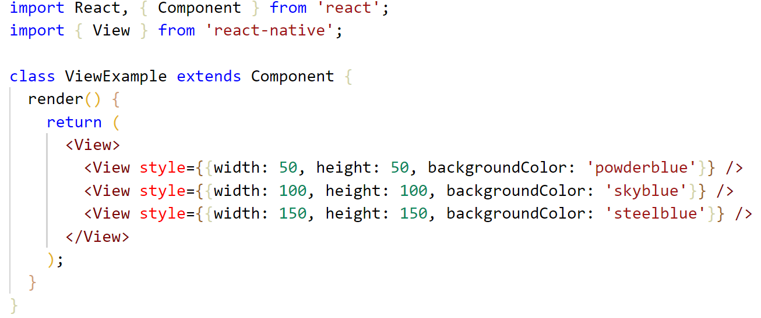
VIEW COMPONENT EXAMPLE

Slide 3
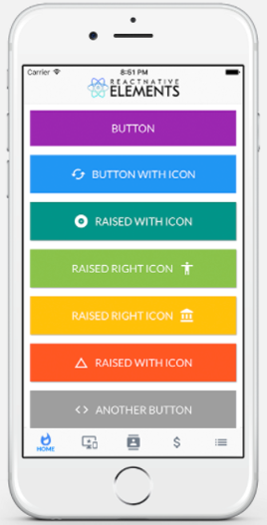
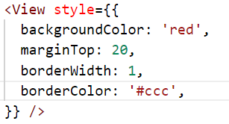
BASIC STYLING
No need to use a special language or syntax for defining styles.
All of the core components accept a prop named style.
The styles names and values usually match how CSS works on the web ( except names are written using camel casing: background-color → backgroundColor )
The style prop can be a plain old JavaScript object.
Notes:
https://github.com/vhpoet/react-native-styling-cheat-sheet

Slide 4
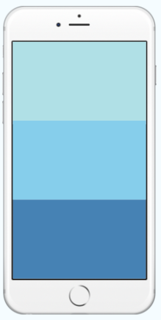
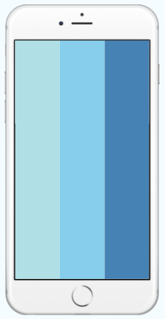
FLEXDIRECTION
Adding flexDirection to a component's style determines the primary axis of its layout. Available options:
column
row
column
row

Slide 5
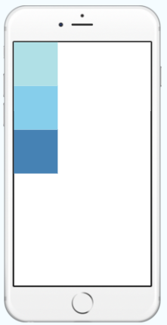
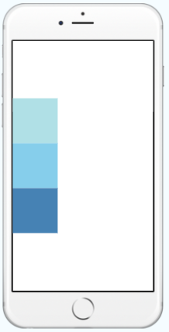
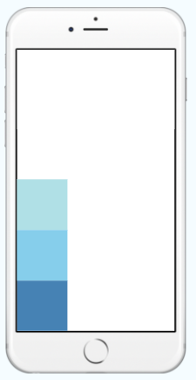
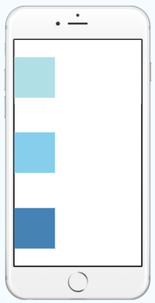
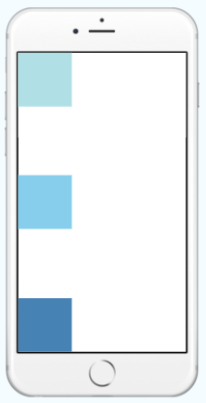
JUSTIFYCONTENT
Adding justifyContent to a component's style determines the secondary axis of its layout.
Available options:
flex-start
center
flex-end
space-around
space-between
flex-start
center
flex-end
space-around
space-between

Slide 6
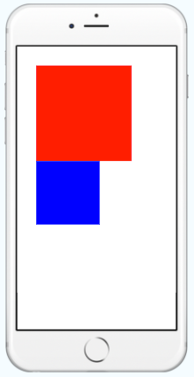
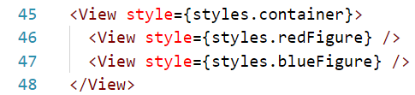
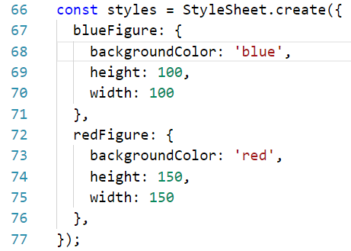
STYLESHEET
Use StyleSheet.create to define several styles in one place.

Slide 7
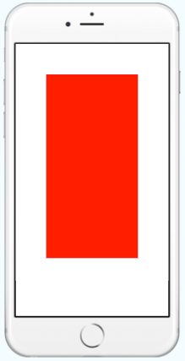
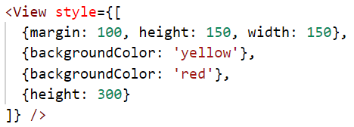
Inline styles
You can pass an array of styles - the last style in the array has precedence,
so you can use this to inherit styles.

Slide 8
TEXT COMPONENT
A React component for displaying text, that supports nesting, styling, and touch handling.
Supports styling which is quite similar to web, like fontFamily, color, fontWeight, fontSize, lineHeight, shadows and etc.
Contains some useful props for mobile development: ellipsizeMode, numberOfLines, onPress and etc.
Notes:
http://facebook.github.io/react-native/releases/0.49/docs/text.html#text

Slide 9
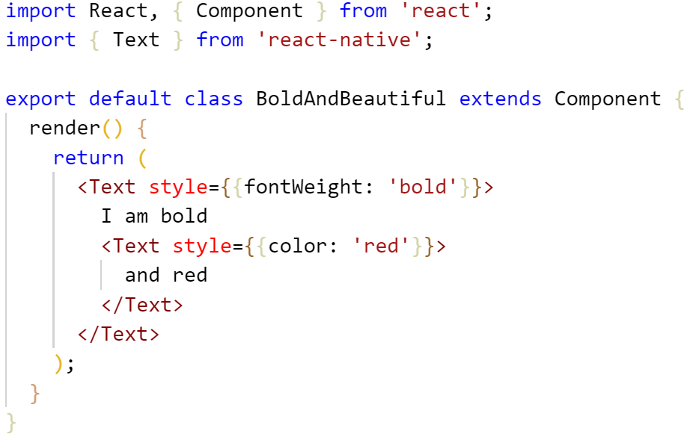
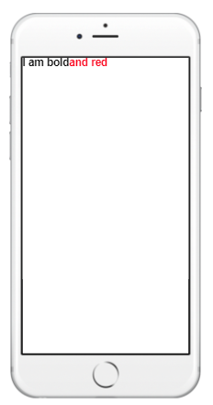
NESTED TEXT COMPONENTS

Slide 10
IMAGE COMPONENT
Easy to use:
Benefits:
Same system on iOS and Android.
Images live in the same folder as your JavaScript code. Components are self-contained.
No global namespace, i.e. you don't have to worry about name collisions.
Images that are actually used will be packaged into your app.
Adding and changing images doesn't require app recompilation, just refresh the simulator as you normally do.
The packager knows the image dimensions, no need to duplicate it in the code.
May have several sources specified for different screen sizes (the native part choses the best match).

Slide 11
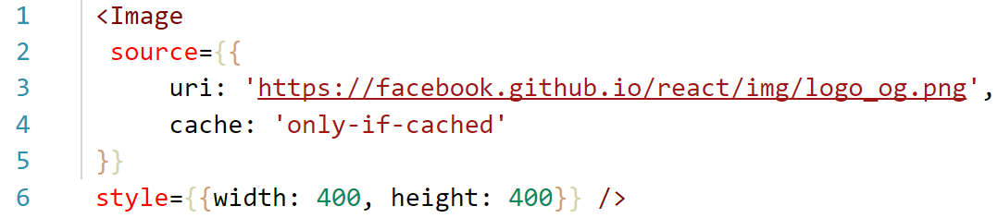
CACHE AND LOAD CONROL
Image component provides some handlers that allows you to control loading the image: onLoad, onLoadEnd, onLoadStart, onError.
On IOS you are able to control cache:
Possible cache settings: ‘only-if-cached’, ‘force-cache’, ‘reload’, ‘default’.

Slide 12
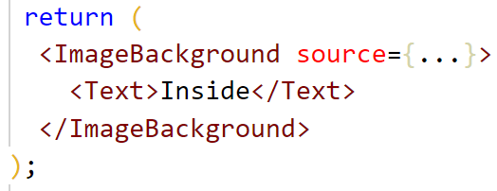
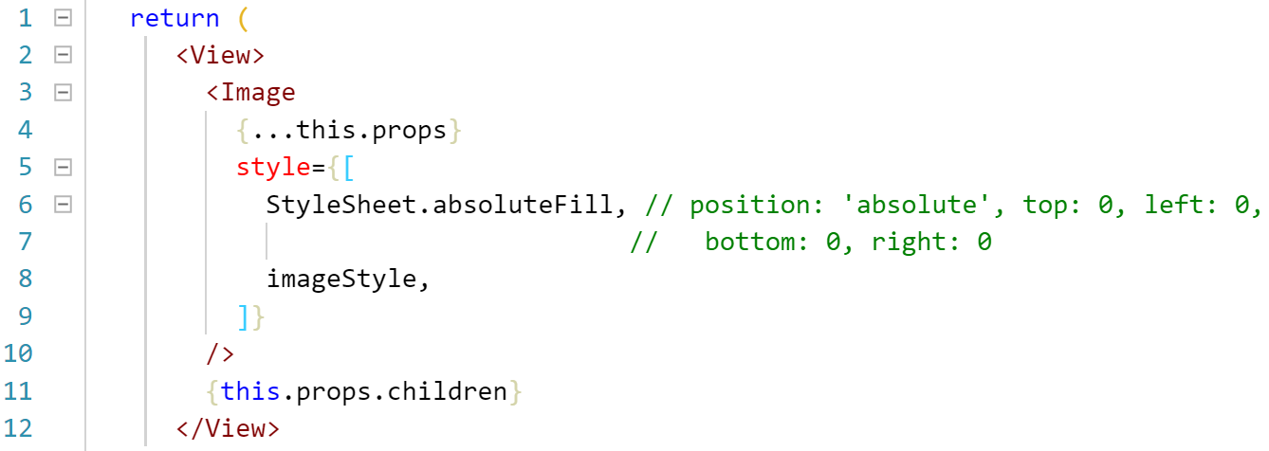
BACKGROUND IMAGE
ImageBackground is same like Image but provides the nesting.
Under the hood it has very simple implementation:

Slide 13
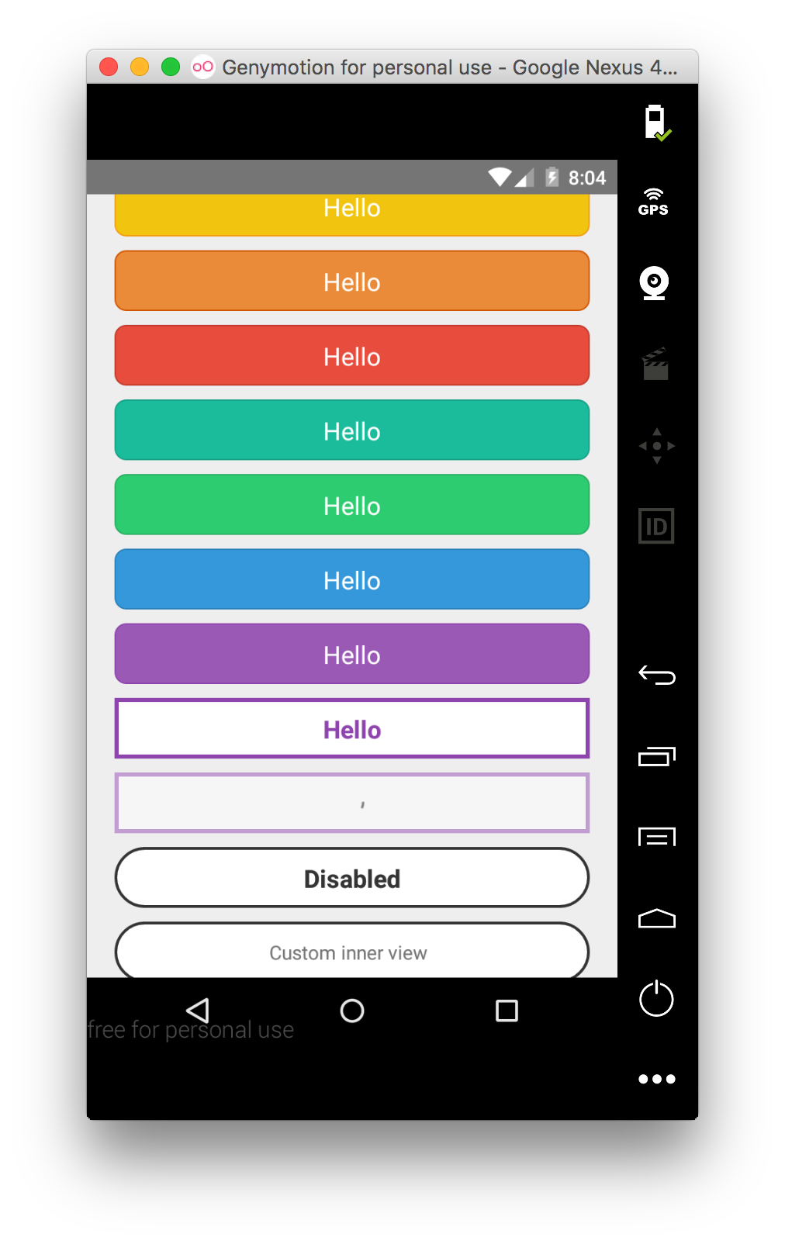
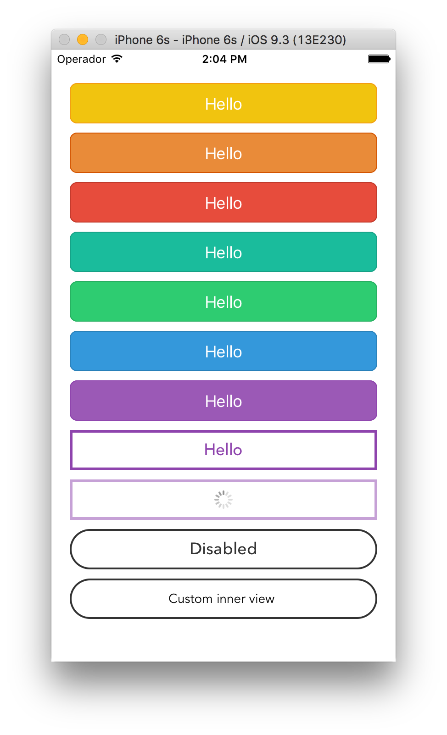
BUTTON COMPONENT
A basic button component renders nicely on any platform.

Slide 14

BUILD YOUR OWN BUTTON
If the react-native Button does not look like properly for your app, make your own!
Main components for handling touches:
TouchableOpacity
TouchableWithoutFeedback.
TouchableHighlight
TouchableNativeFeedback

